Slide 1

rockbuster stealth
Data Analysis - Jean-Claude du Sart

Slide 2

AGENDA
● Project Objective
● Questions to Address
● Summary of Take Away Stats and Recommendations
● Thank You and Questions

Slide 3

Project objective
Rockbuster needs to stay competitive against the likes of Netflix and Amazon Prime. The aim of this project is thus to help Rockbuster with the launch strategy for their new online video rental services.
Rockbuster Stealth aims to address several business questions with Analysis prior to this launch. Our Objective is to gain insights from the Analysis to provide insights and recommendations for the launch strategy.

Slide 4

Questions to address
● Which movies contributed the most/least to revenue gain?
● What was the average rental duration for all videos?
● Which countries are Rockbuster customers based in?
● Where are customers with a high lifetime value based?
● Do sales figures vary between geographic regions?

Slide 5


Which movies contributed the most/least to revenue gain?

Slide 6
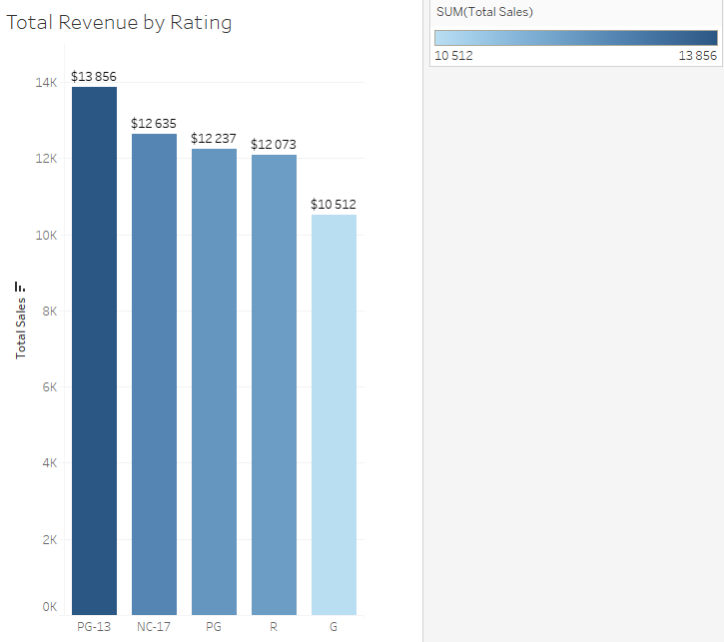
PG-13 rating has the highest sales whilst rating G has lowest Sales
Link to Tableu

Slide 7
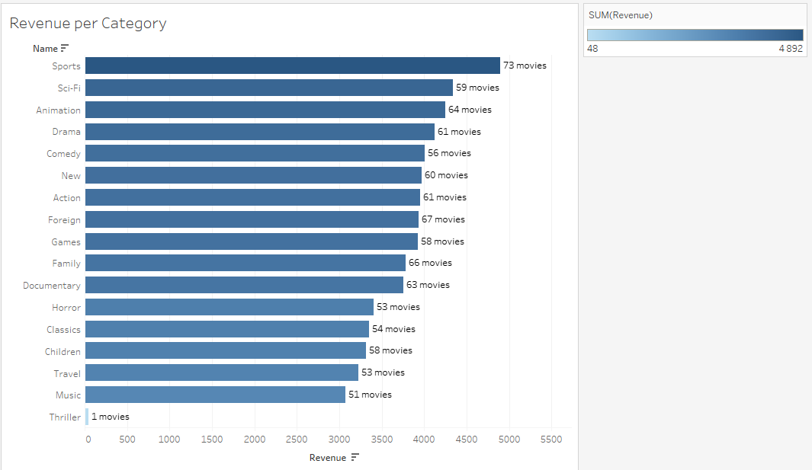
Top 5
Categories
Bottom 5 Categories
Sport, Sci-Fi, Animation, Drama and Comedy are the top 5 Categories whilst Classics, Children, Travel, Music and Thriller are the bottom 5 Categories
Link to Tableu

Slide 8
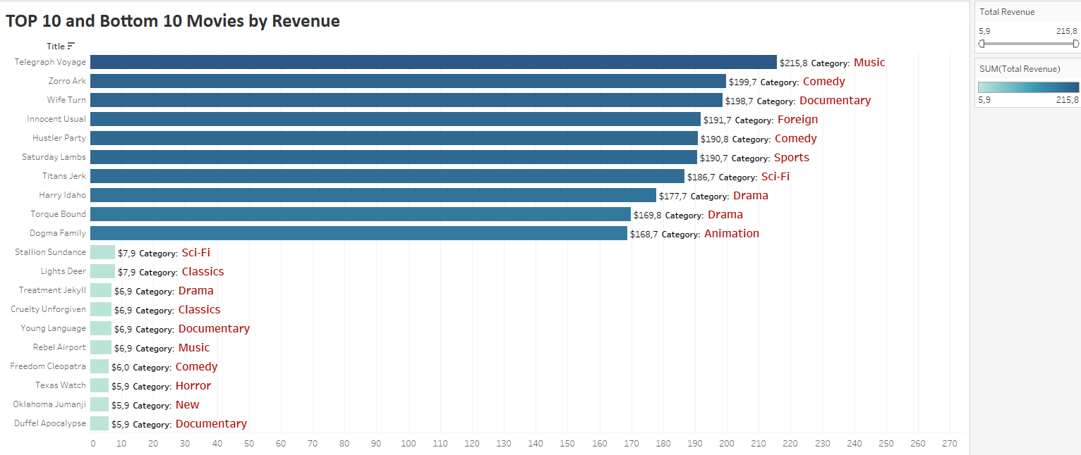
The Top movies are Telegraph Voyage, Zorro Ark and Wife Turn whilst the bottom 3 are Texas Watch, Oklahoma Jumanji and Duffel Apocolypse
Link to Tableu

Slide 9
What was the average rental duration for all videos?

Slide 10
 | Rental Duration | Rental Movie Length
Minimum | 3 Days | 46 min
Maximum | 7 Days | 185 min
Average | 5 Days | 115 min
Thriller | 7 days
Sports | 5 days
Games | 5 days
Comedy | 5 days
Sci-Fi | 5 days
Music | 5 days
Documentary | 5 days
Horror | 5 days
Family | 5 days
Action | 5 days
New | 5 days
Foreign | 5 days
Children | 4 days
Classics | 4 days
Drama | 4 days
Animation | 4 days
Travel | 4 days
Average rental duration is 5 days over all movies.
With Thriller having an average of 7 days and
Travel Category being just under 5 days

Slide 11
Which countries are Rockbuster customers based in?

Slide 12
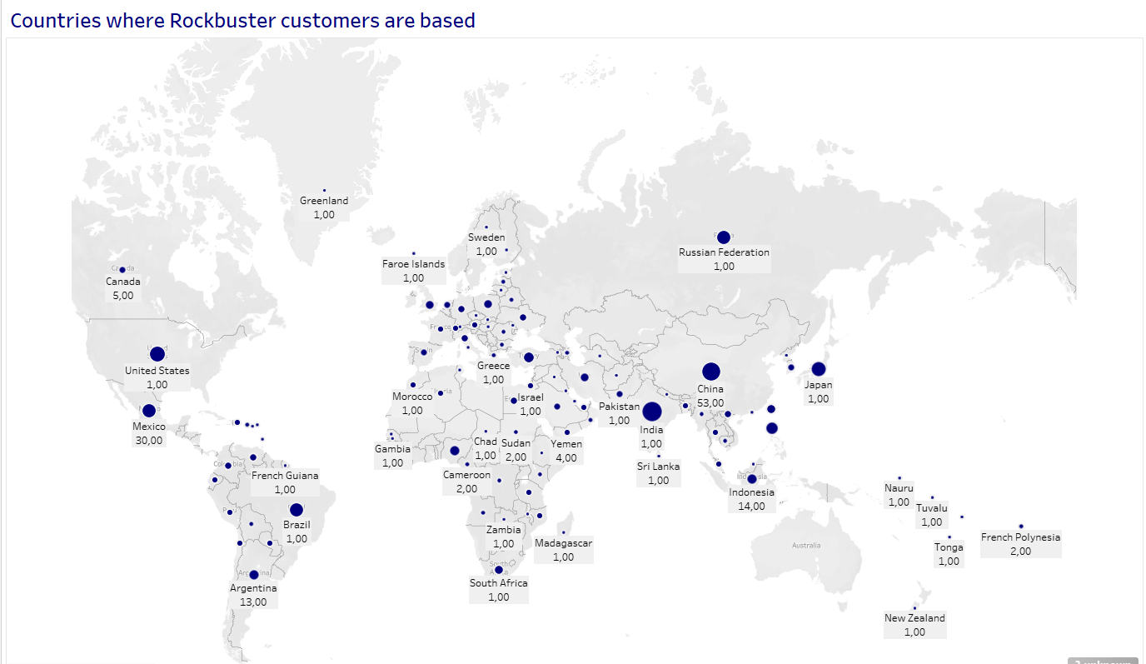
Rockbuster has 599 Customers spread over 108 countries worldwide.
315 (52%)
come from the top
10 countries.
India, China and Japan make up almost half of all the customers.
283 (48%)
customers come from the remaining
98 countries.
There are ZERO customers in Australia.
Link to Tableu

Slide 13
Where are customers with a high lifetime value based?

Slide 14
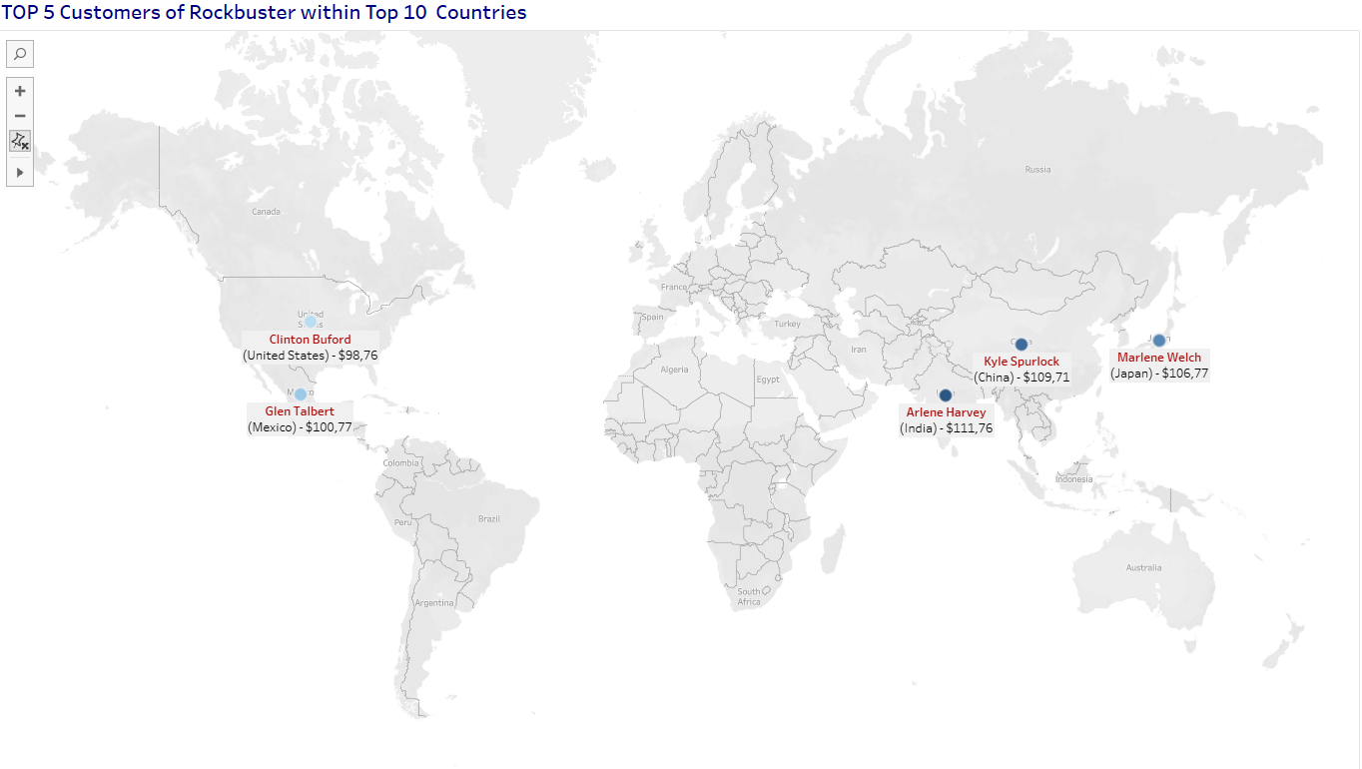
Link to Tableu
Rockbusters top 5 Customers are spread over 5 different countries
worldwide with very little difference in the value of their spend.

Slide 15
Do sales figures vary between geographic regions?

Slide 16
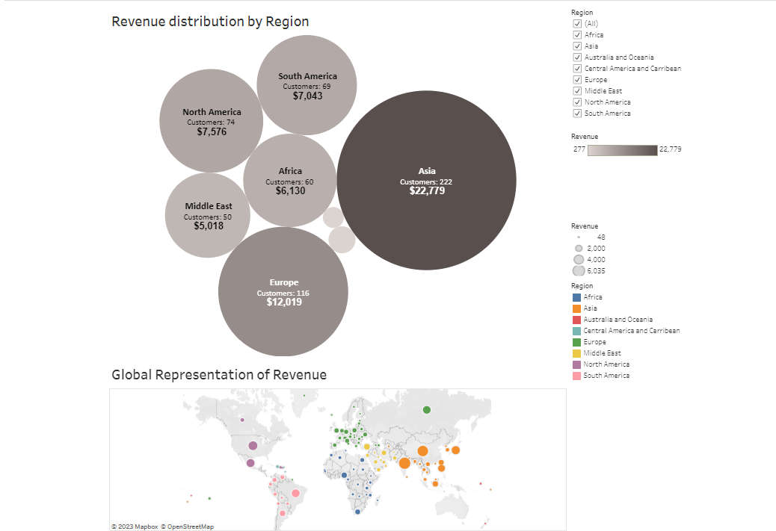
Total Revenue over
the 6 Regions is $61312,04
ASIA tops the list
of Regions with 37%
of the total global revenue
A big difference from any other Region
ranging between
8% and 12 %
Link to Tableu

Slide 17
Summary of Take Away Stats and recommendations

Slide 18
Which movies contributed the most/least to revenue gain? - PG-13 rating has the highest sales whilst rating G has lowest Sales. - Sport, Sci-Fi, Animation, Drama and Comedy are top 5 Categories whilst Classics, Children, Travel, Music and Thriller are bottom 5 Categories. - The Top movies are Telegraph Voyage, Zorro Ark and Wife Turn whilst the bottom 3 are Texas Watch, Oklahoma Jumanji and Duffel Apocolypse. From the above insights I would recommend that an increase in range for Thriller movies should be available to increase revenue on that Category. Top Categories do not mean top movies as in the case of “Telegraph Voyage” being in Musical Category, however increasing the top 10 movies in inventory could make more availability for customers and limiting or removing the bottom Movies from the Inventory to allow for this What was the average rental duration for all videos? - Average rental over all categories are 5 days with Thriller being 7 days the highest From the above insight I would recommend that there should be a scale as to renting movies. Possibly 1-2 movies should be 3 days, 3-4 movies 4 days and 5-6 movies 7 days permitted. This will get customers to watch the movies within the time period allocated for online use before expiring and get them to order more frequently the next set of movies.
Which countries are Rockbuster customers based in? - Rockbuster has 599 Customers spread over 108 countries worldwide. 315 (52%) come from the top 10 countries. 283 (48%) customers come from the remaining 98 countries. There are ZERO customers in Australia. From the above insight I would recommend that a portion of the marketing budget be set aside for the Australia Region to build some customers where Rockbuster has not reached. Focus should remain on the customers from the top 10 countries and further analysis be done on the remaining 98 countries to increase revenue. Where are customers with a high lifetime value based? - Rockbusters top 5 Customers are spread over 5 different countries worldwide with very little difference in the value of their spend. To retain the existing customers that are bringing in the most revenue I would recommend incentive programs/coupons for certain spending to keep them interested. Do sales figures vary between geographic regions? - Total Revenue over the 6 Regions is $61312,04, ASIA tops the list of Regions with 37% of the total global revenue, A big difference from any other Region ranging between 8% and 12 %
Keep the marketing budget within proportion of where the revenue is in each Region. Focus on ASIA where some of the top customers are in as well. Explore other demographic reasons as to why it could be lower in other Regions.

Slide 19

THANKS! For any further insights/analysis you may reach out to: Data Analyst | Jean-Claude du Sart jeanclauded.jcds@gmail.com

